Slide 1
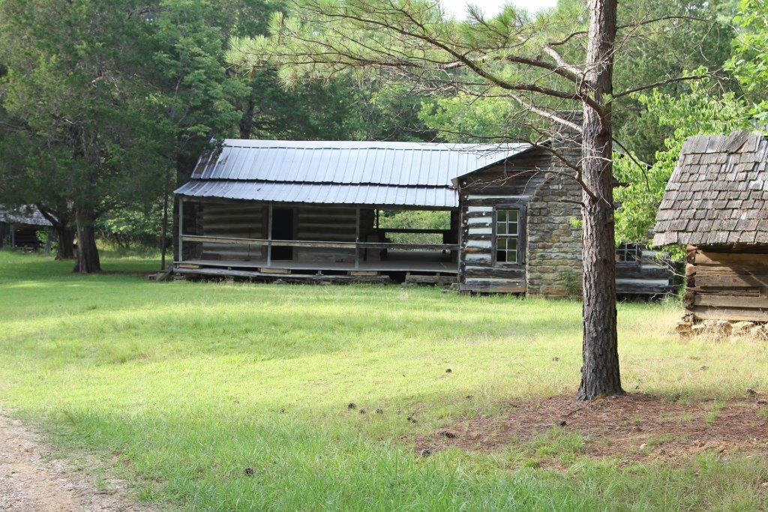
The Frontier Era
Overton Farm

Slide 2
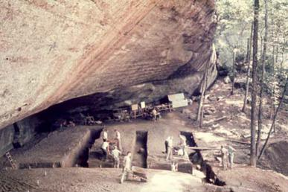
The Earliest Inhabitants
Stanfield-Worley Shelter inhabited by Paleoindians through Mississippian period
Discovered in 1960
Paleoindian: ~15,000-9,000 years ago
Mississippian Period: 1000-1550 CE
Stanfield-Worley Bluff Shelter

Slide 3
European Contact and Settlement
French trading post at Muscle Shoals before 1715
Cherokee villages in the latter eighteenth century
The village of Oka Kapassa was established around 1770
Several clashes between the Native Americans and the earliest white settlers
After Oka Kapassa battle white settlement increased

Slide 4
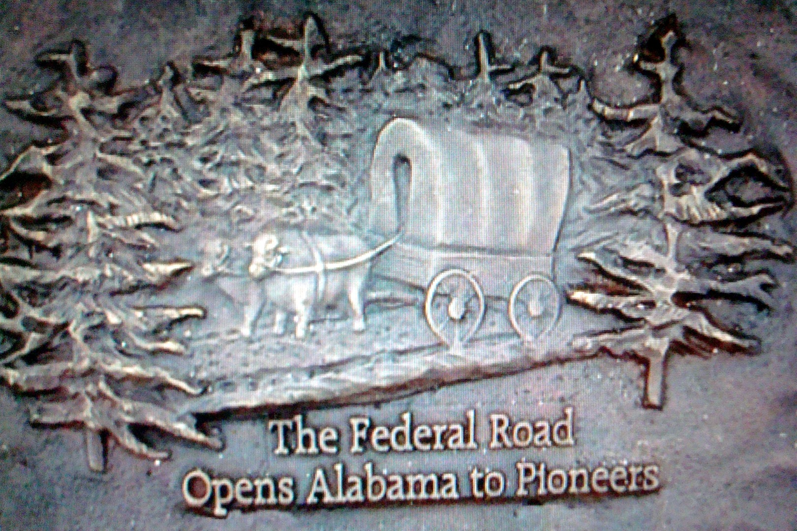
Alabama Fever
1812: government sells 144,873 acres in the Mississippi Territory
1813-14: Creek Wars cause a sharp decrease in land sales. In 1813, only 30,261 acres were sold
March 27, 1814: End of Creek War, “Alabama Fever” begins
1810-1820: population of Alabama increased more than 1,000%

Slide 5
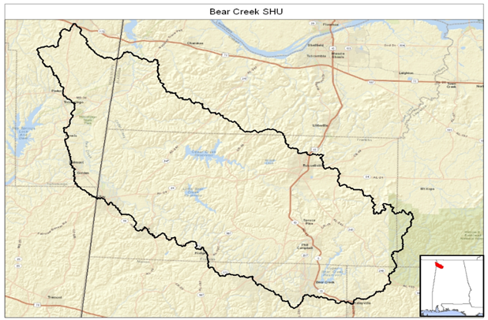
Settling the Bear Creek Watershed
The watershed includes the majority of Franklin County, and also smaller portions of Marion, Colbert, Winston, and Lawrence Counties in Alabama, and Tishomingo County, Mississippi
The watershed covers 801 square miles or 513,121 acres

Slide 6
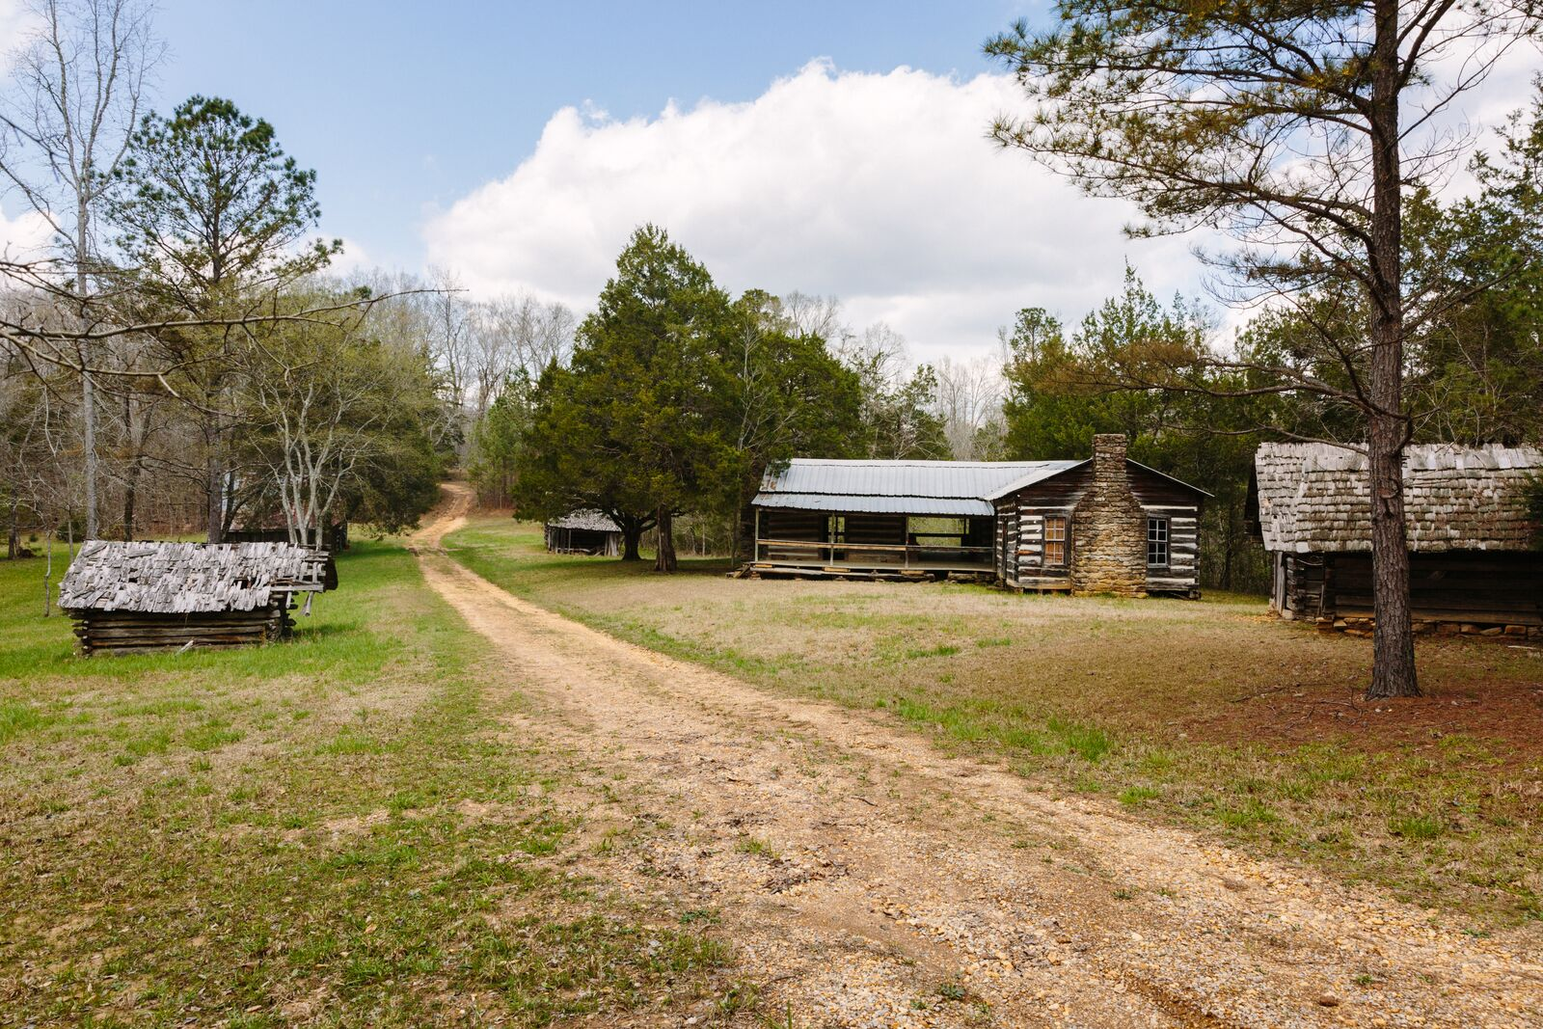
Abner Overton comes to Alabama: An example of Alabama Fever
During “Alabama fever” the Overton family first made their way into northwest Alabama
1815 - Abner Overton visits Alabama to sell tobacco
1817 - Abner Overton returns to buy land near Hodges and settle

Slide 7
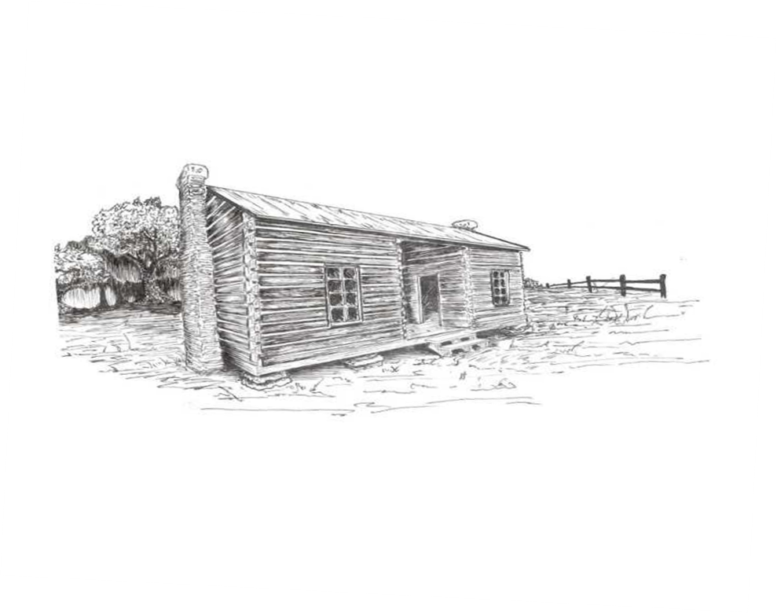
Building a Home on the Frontier
In 1838, the Overton family began to construct their second home
Over the years rooms were added until it became a five room, dogtrot-style house
Dogtrot homes were popular in the region because the breezeway between the sections allowed for airflow during the hot, humid summers

Slide 8
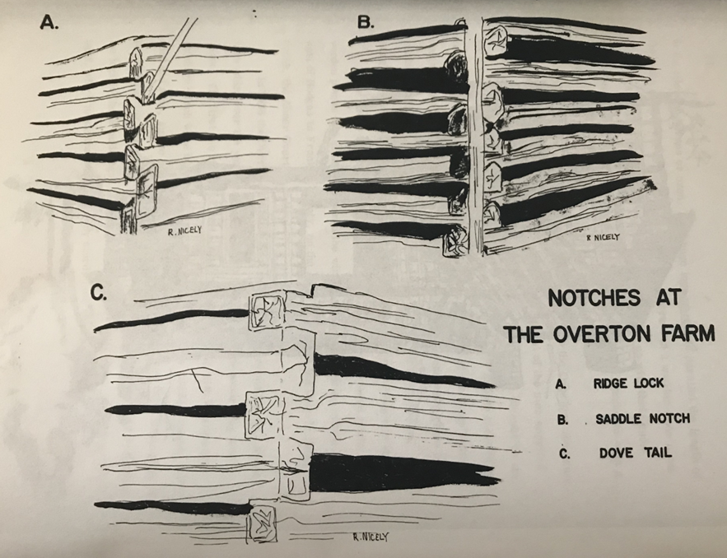
Dog-trot Houses
The Overton home uses three types of notches
Normally only one type of notch was used
The notches used were the Ridge Lock, Saddle Notch, and Dovetail

Slide 9
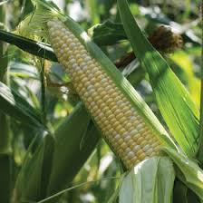
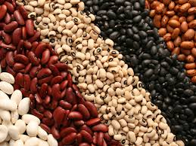
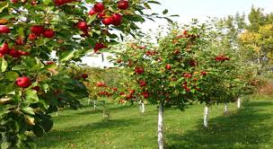
Life on the Farm
Corn was the staple crop
Beans and peas were planted along with the corn so the vines could be supported by the corn stalks and make more use of the field area
The Overtons also planted numerous fruit trees
Making the most of field space was extremely important. Families had to produce almost all their daily food requirements

Slide 10
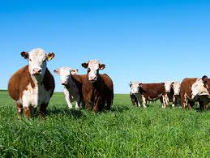
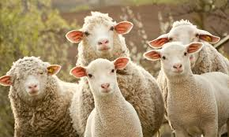
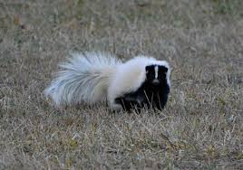
Animals on the Frontier
The Overton family raised cattle, hogs, sheep, mules, and horses
Furs from animals such as beaver, mink, and skunk who were trapped or hunted on the property were also sold or used for trading

Slide 11
Discussion Topics
Who were the earliest inhabitants of Northwest Alabama?
Name two of the later Native American tribes that lived in the area.
What was “Alabama Fever”?
What first brought Abner Overton to Alabama and why did he decide to come back to stay?
Why were dog-trot houses common in Alabama?
How do the different types of notches work in constructing a home?
What crops did frontier era families raise and why?
What types of animals did they raise and what was each one used for?

